Slide 1
Kickstarter Classification Model (EDA):
Can we accurately predict the crowdfunding success of a given venture?

Slide 2
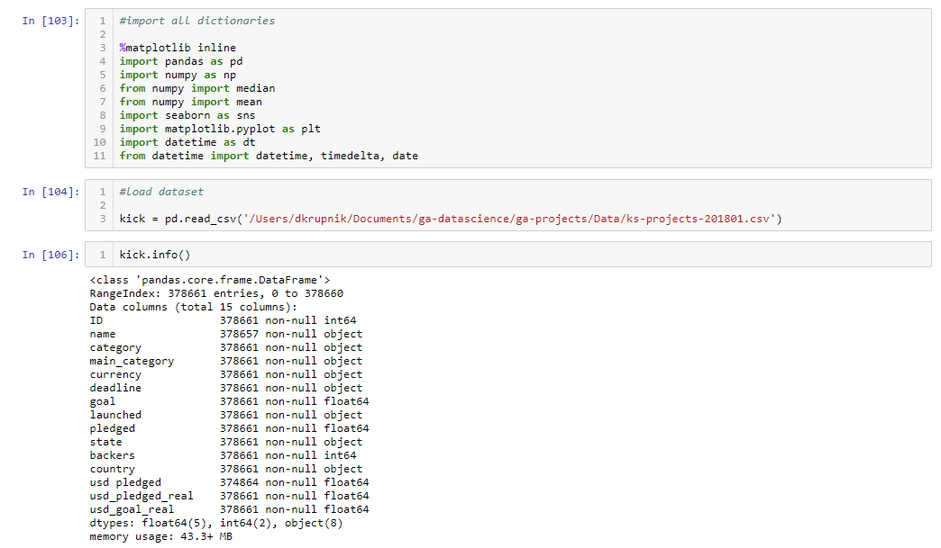
Importing all modules and examining the dataset

Slide 3
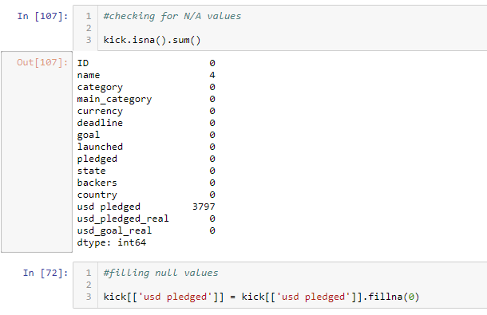
Identifying & cleaning null values

Slide 4
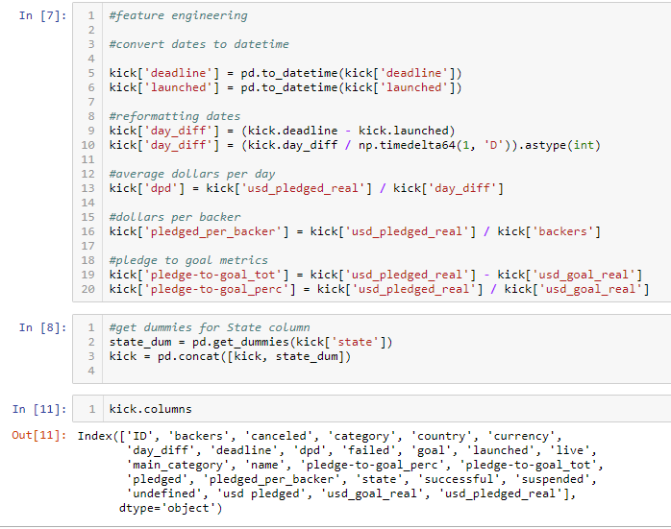
Feature engineering & creating dummy variables

Slide 5
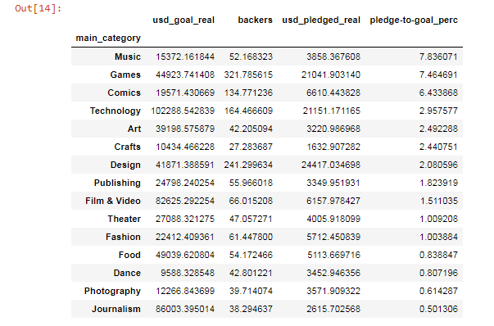
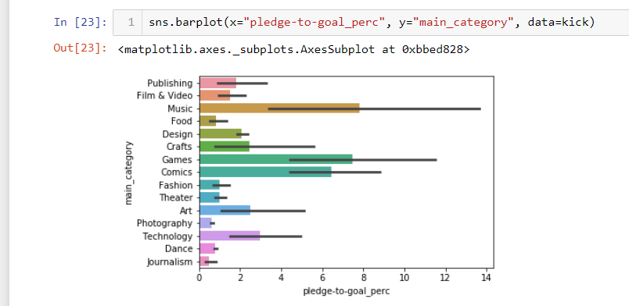
Identifying a narrative for Category success
kick.groupby('main_category')['usd_goal_real', 'backers', 'usd_pledged_real', 'pledge-to-goal_perc'].mean().sort_values('pledge-to-goal_perc', ascending = False)

Slide 6
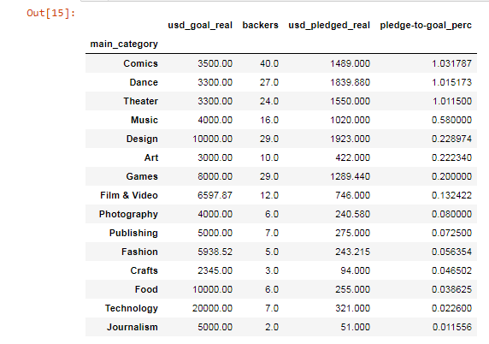
Identifying a narrative for Category success
kick.groupby('main_category')['usd_goal_real', 'backers', 'usd_pledged_real', 'pledge-to-goal_perc'].median().sort_values('pledge-to-goal_perc', ascending = False)

Slide 7
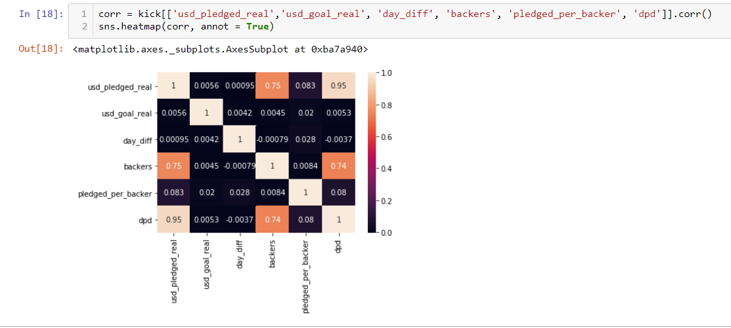
Understanding relationships between key variables

Slide 8
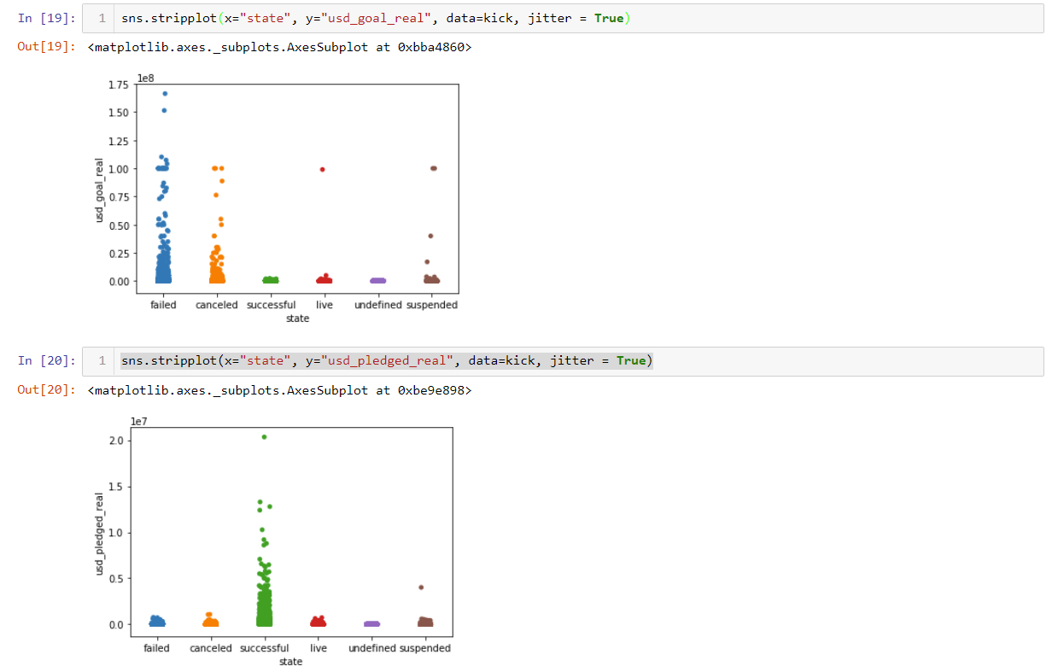
Visualizing Pledge & Goal distributions by success

Slide 9
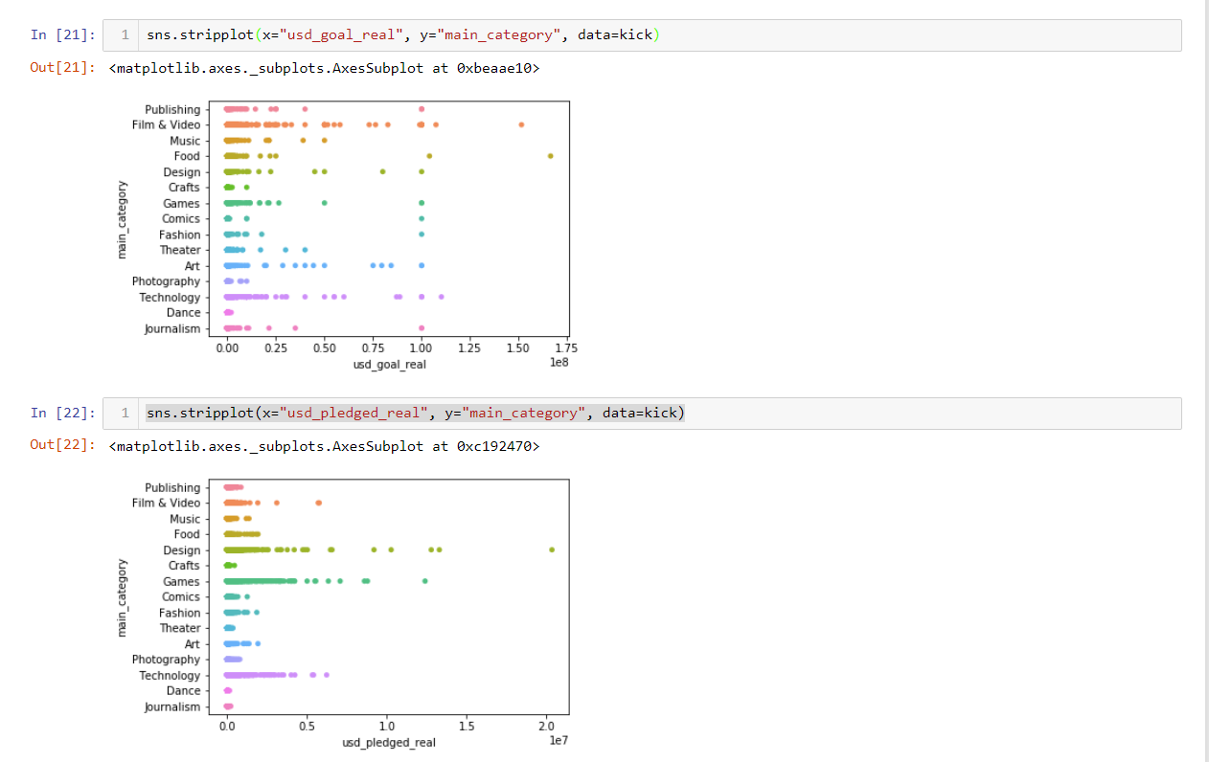
Visualizing Pledge & Goal distributions by success

